Slide 1




C# MVC Frameworks – ASP.NET Core
Course Introduction
C# MVC Frameworks
SoftUni Team
Technical Trainers
Software University
http://softuni.bg

Slide 2


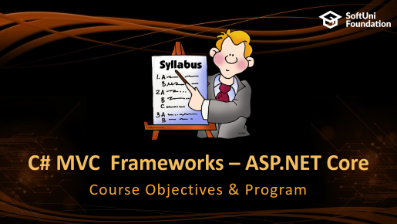

Table of Contents

Slide 3



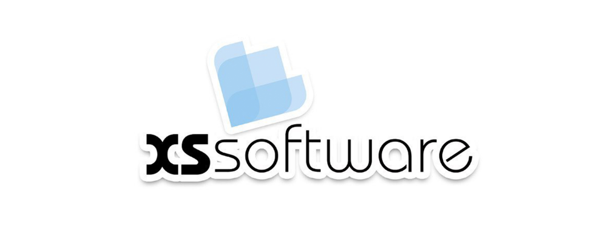


SoftUni Diamond Partners

Slide 4






SoftUni Diamond Partners

Slide 5
Questions
sli.do #csharp-web

Slide 6

C# MVC Frameworks – ASP.NET Core
Course Objectives & Program

Slide 7
C# Web Module at SoftUni – Timeline
14-May-2018
1-July-2018
August-2018
C# Web Development Basics
Lessons + exercises + exam
6 weeks * 4 times / week
12 credits
Start: 14-May-2018
Exam: 01-July-2018
C# MVC Frameworks
Lessons + exercises + exam
6 weeks * 4 times / week
18 credits
Start: 02-July-2018
Project Defense: 26-August-2018
C# Web Re-Take Exams
Last week of August 2018 & First week of September 2018

Slide 8
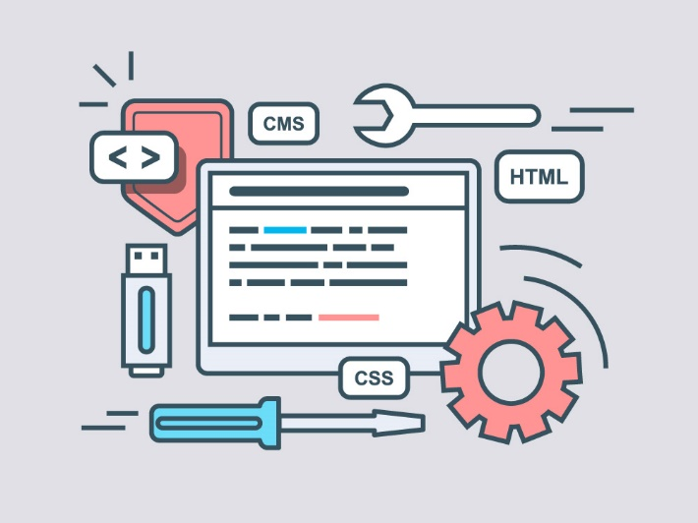
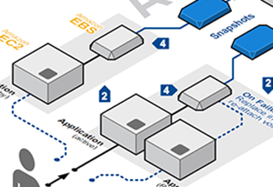
Course Objectives
The C# MVC Frameworks course provides
In-depth knowledge in the ASP.NET Core Framework
Knowledge for creating RESTful services
Architectural design
Best practices in modern ASP.NET Core applications
Deployment

Slide 9
Course Program
Course Introduction – Course Program, Trainers, Exams, Resources
ASP.NET Core Intro – Overview, setup, components, architecture
Razor Pages – a new look at an old concept
MVC Essentials – Routing, controllers, middlewares, Razor basics
Razor Engine – Advanced syntax, controls and helpers, validation
Lifecycle – methods, built-in filters, custom filters
Identity – Authentication, roles, Identity filters

Slide 10
Course Program (2)
Architecture I – areas, service layer, model binders, IoC & auto-mapping
Architecture II – Session, security, cache, localization
Unit Testing – Unit tests, mocking / fakes, functional tests, Razor pages
ASP.NET Pipeline – Request method pipe override, ASP.NET application lifecycle
Web API – REST Standard, developing / consuming services, CORS
SignalR – Building a real-time application
Other Concepts – file upload, logging, etc.
Individual Project – Building a real application with ASP.NET Core, throughout the course

Slide 11

The Trainers Team

Slide 12
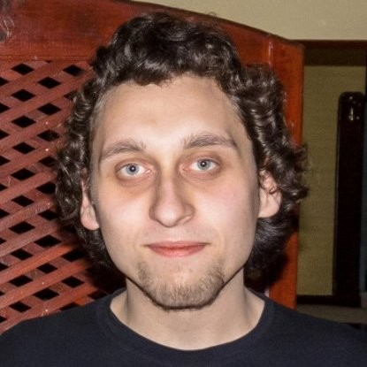
Trainers Team
Yordan Darakchiev
Programmer / .NET / Full-Stack / Web developer Trainer
Various programming courses to beginners and experienced developers
Scientific (and popular) lectures
Scientist / Enthusiast
MSc in Astrophysics
Overall nerd

Slide 13

C# Web Dev Basics: More Details
Duration, Schedule, Languages, etc.

Slide 14


Training Duration – C# Web Dev Basics
Lessons: ~50 hours (onsite + videos)
Practical exercises (in class): ~60 hours
Project preparation: 0+ hours
Final project: 10+ hours
Schedule: 2 July – 13 August 2018
Exam date: 26 August 2018

Slide 15



Learn to Search in Internet & Find Solutions!
The course assignments require to search in Internet
This is an important part of the learning process
Some exercises intentionally have no hints
Learn to find solutions!
Software development includes everyday searching and learning
No excuses, just learn to study!
Developers learn new technologies, tools, languages every day!

Slide 16



C# MVC Frameworks
Evaluation Criteria

Slide 17


Scoring System
Individual Project – 90%
Homework (exercises) – 10%
Bonuses: up to 10%
Presence in class: 5% (onsite students only)
Forum activities
Others

Slide 18


C# MVC Frameworks: ASP.NET Core Exam
Practical web development exam
Implementing a web application
Based on predefined requirements
Applying best practices in software development
On-site defense
Present your project in a limited time
10 minutes

Slide 19

Homework Assignments
Doing your homework is very important!
Programming can only be learned through a lot of practice!
You should write code every day!
Each lesson is followed by many exercises
Try to solve them in class
The rest are your homework
Homework assignments are due in 6 days after each lecture
Solutions are submitted on the course page.

Slide 20










Resources
What We Need Additionally?

Slide 21



C# Web Course Web Site, Forum and FB Group
Official web site:
Official discussion forum:
Official Facebook groups:
https://softuni.bg/courses/asp-net-mvc
https://softuni.bg/forum/categories/31/csharp-mvc-frameworks-asp-net
https://facebook.com/groups/SoftUniCsharpWebMay2018/

Slide 22

Software University Learning System (SULS)
Software University Learning System (SULS)
www.softuni.bg
Important resource for students
Homework submissions
Homework check-up
Exams and results
Reports about your progress
…

Slide 23
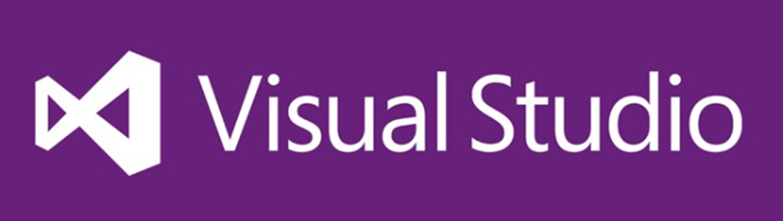

Required Software
Software needed for this course:
Microsoft Windows (Win 10 / 8.1 / Win8 / Win7) or Mac or Linux
Visual Studio Community 2017 (a free version of VS 2017)
Microsoft SQL Server (a free version of MSSQL Server)

Slide 24




Summary
Training program
Practical exam
An Individual Project, build throughout the Course
Learning resources
Slides, videos, software, forum

Slide 25







C# MVC Frameworks – Course Introduction
https://softuni.bg/courses/asp-net-mvc

Slide 26
License
This course (slides, examples, demos, videos, homework, etc.) is licensed under the "Creative Commons Attribution-NonCommercial-ShareAlike 4.0 International" license

Slide 27





Trainings @ Software University (SoftUni)
Software University – High-Quality Education, Profession and Job for Software Developers
softuni.bg
Software University Foundation
http://softuni.foundation/
Software University @ Facebook
facebook.com/SoftwareUniversity
Software University Forums
forum.softuni.bg

